Slide 1
2Danalysis: A toolbox for analysis of lipid membranes and biopolymers in two-dimensional space
Ricardo Ramirez
Advisor: Viviana Monje

Slide 2
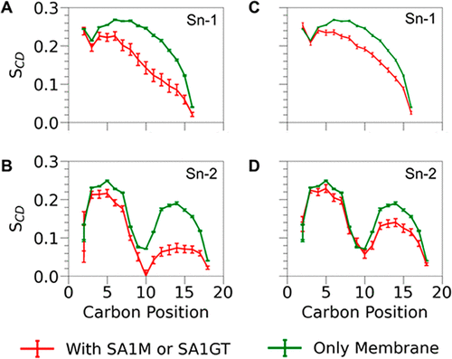
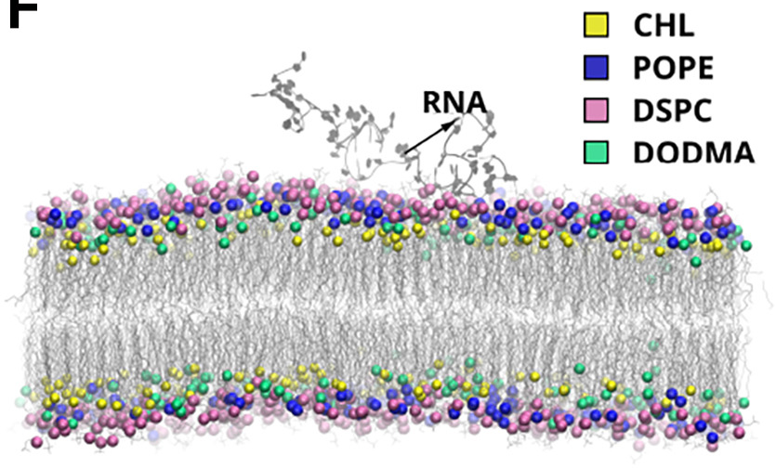
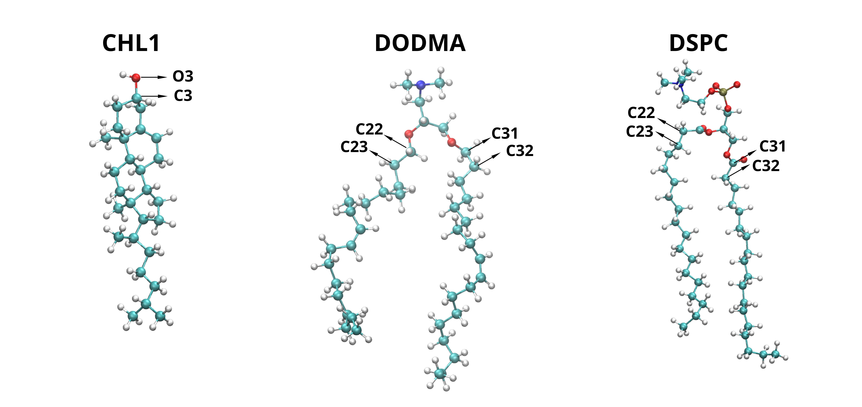
Problem
Complex membranes are composed by several lipids, with different structural characteristics.
There is not much standardized software to analyze membranes.
Some analysis focuses on the bulk properties (Cannot characterize local behavior).
Biopolymers interacting with the surface benefit from a 2D approach.
Jinhui Li and Viviana Monje-Galvan ACS Applied Bio Materials 2024 7 (2), 553-563 DOI:10.1021/acsabm.2c00928

Slide 3



Our work: Code development project
Created a software package to study membrane and biopolymers and added it to add to MDAKits.
Created modular architecture software, to ease changes or adding new features.
Wrote detailed documentation accessible for new users.
Facilitates the build of pipelines and the automatize the application of the analysis for several replicates

Slide 4
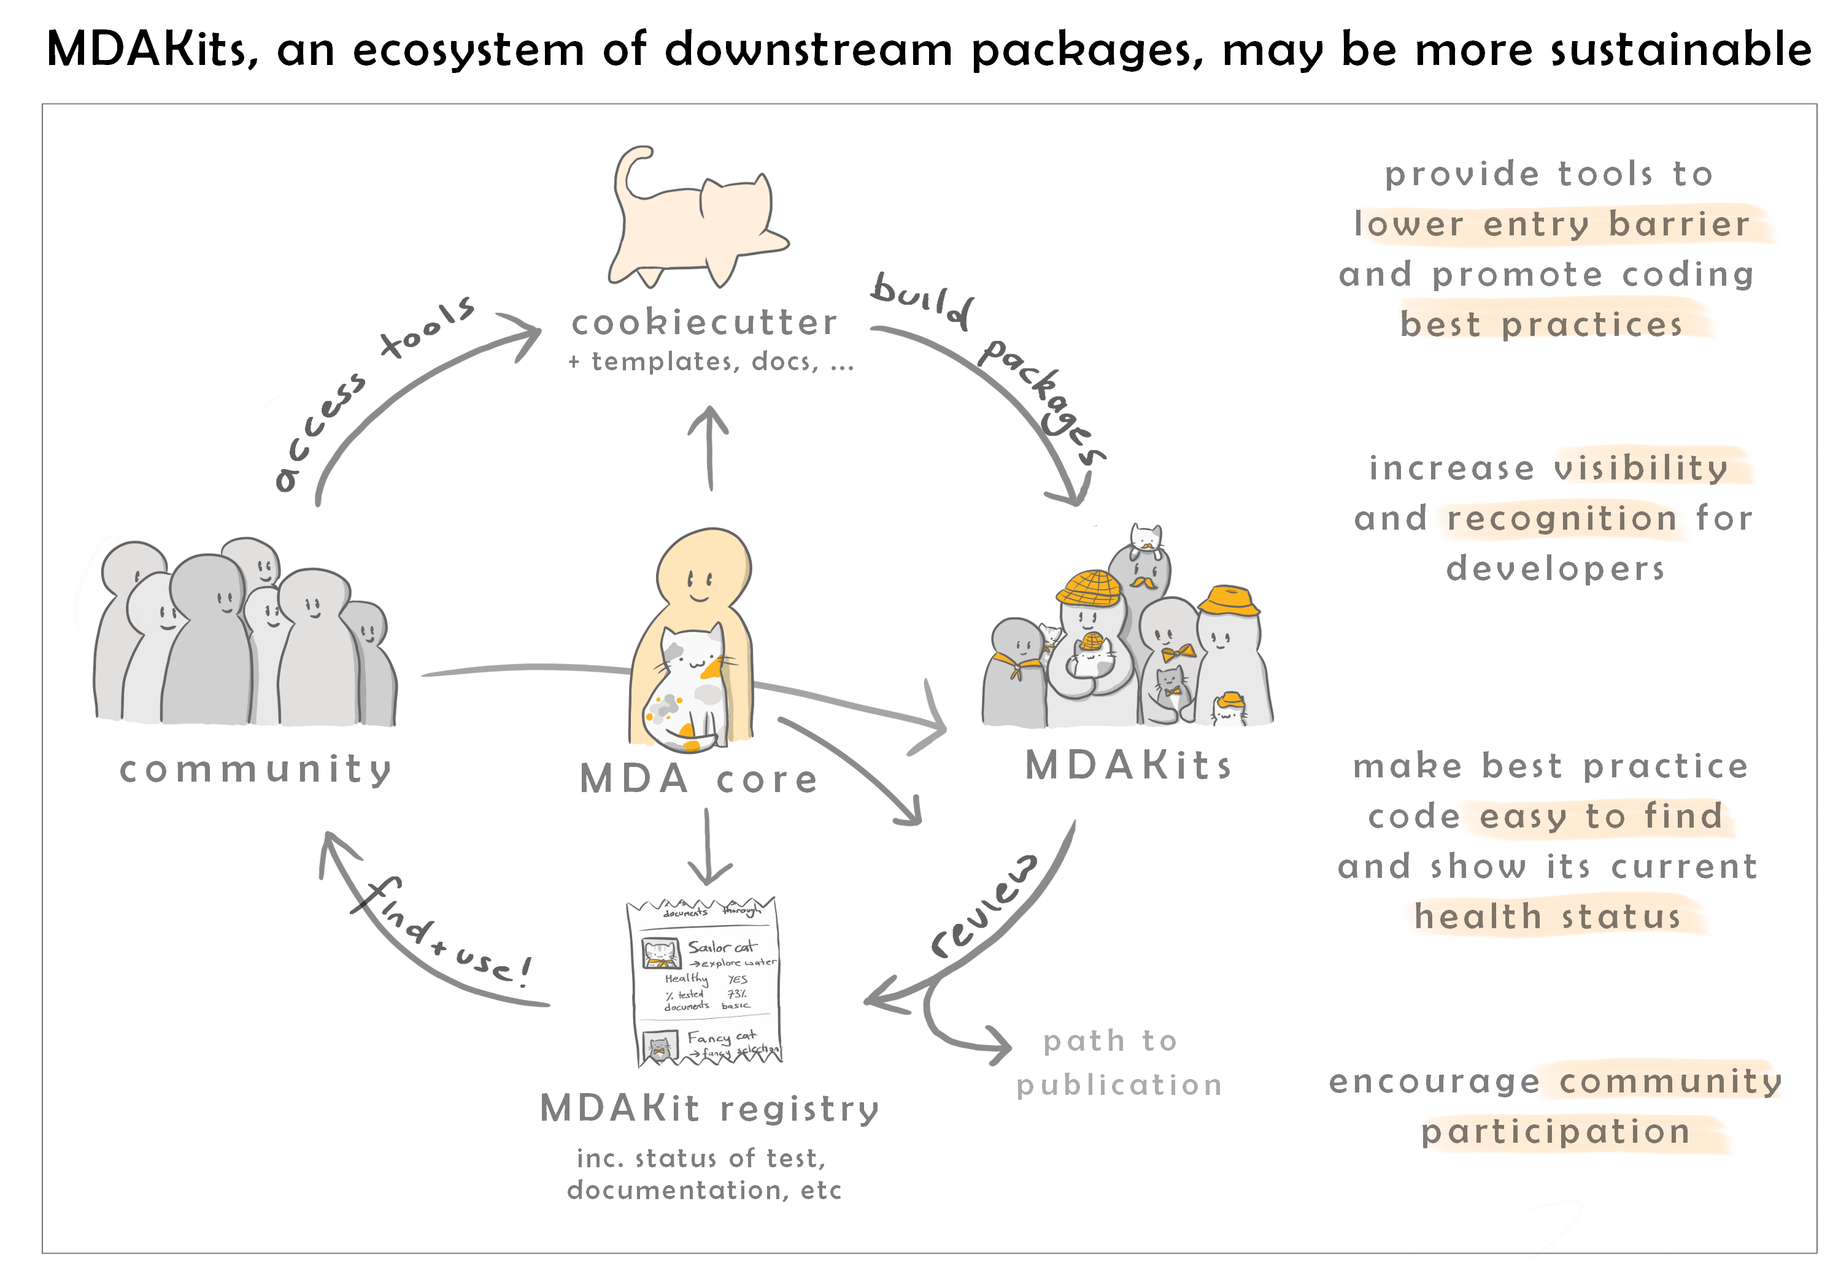

MDAKits

Slide 5
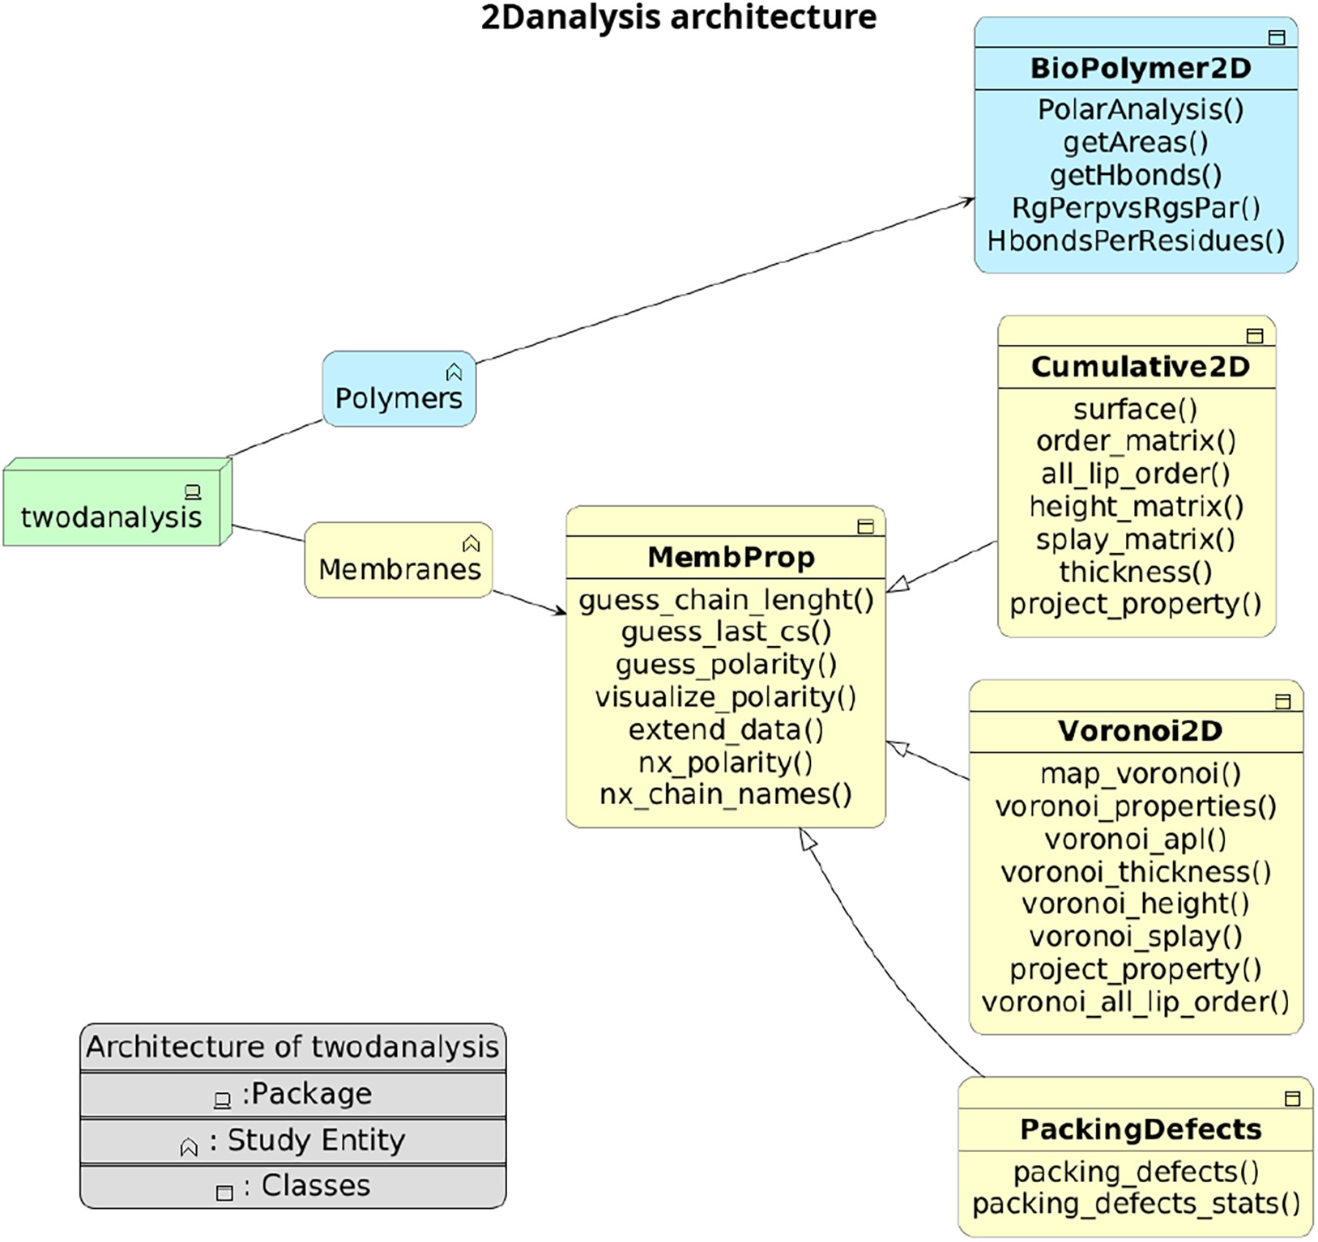
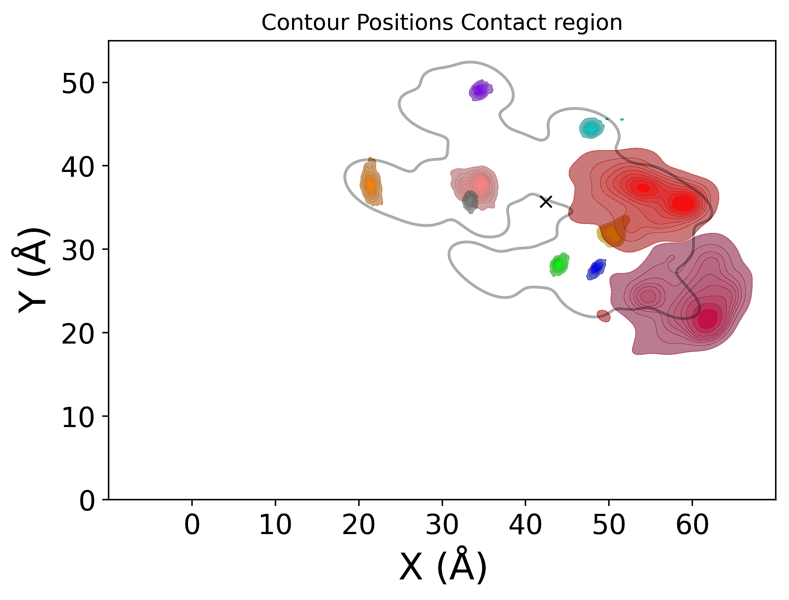
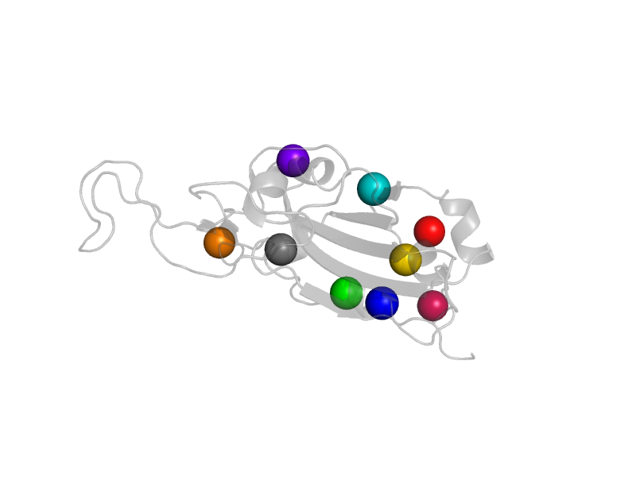
Architecture

Slide 6
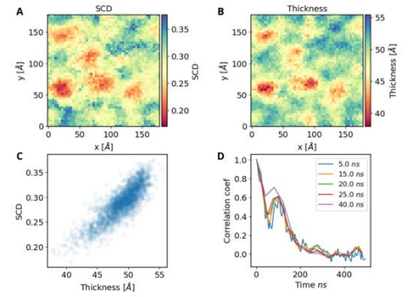
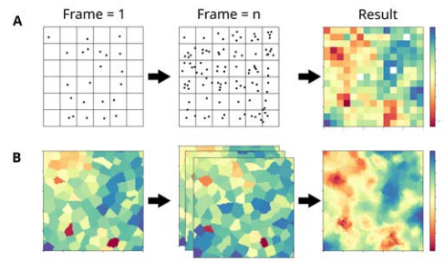
Cumulative2D/Voronoi2D
Projection of membrane properties on the xy plane.
Two protocols used.
Allows us for detection of changes in localized regions.
Define time windows for analysis.
Temporal/Spatial correlation of membrane properties

Slide 7
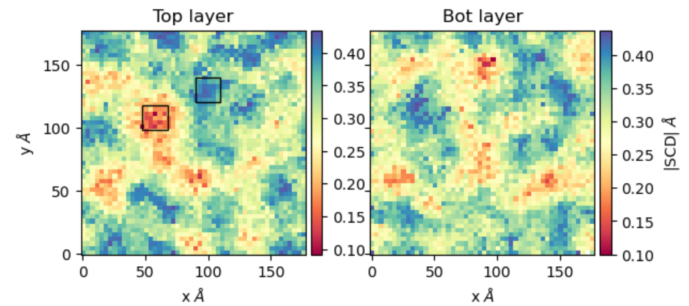
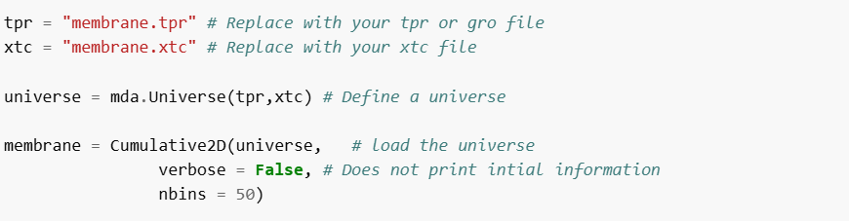
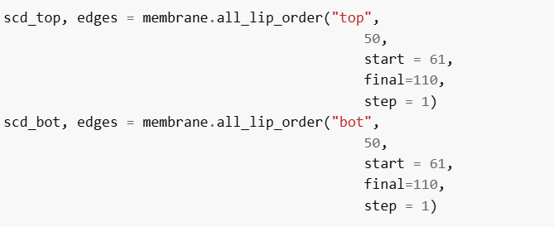
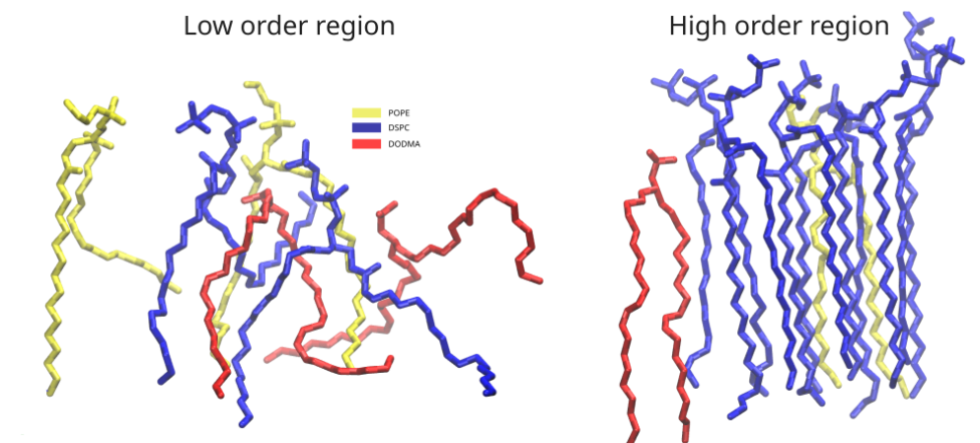
Order parameters (SCD)

Slide 8
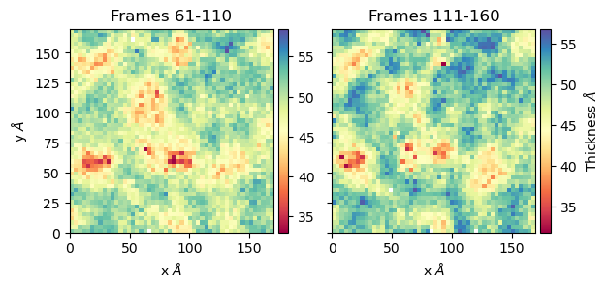
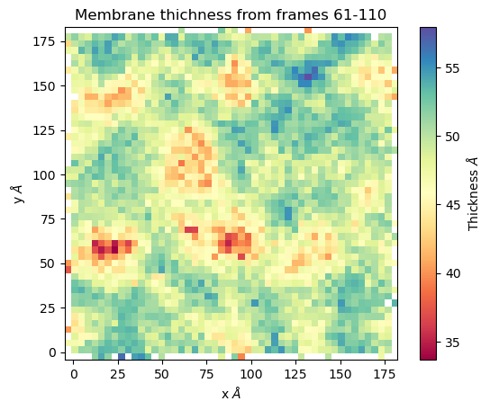
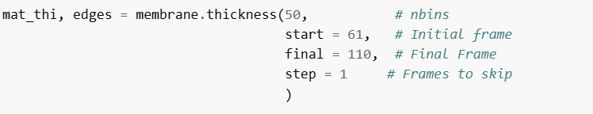
Membrane thickness

Slide 9
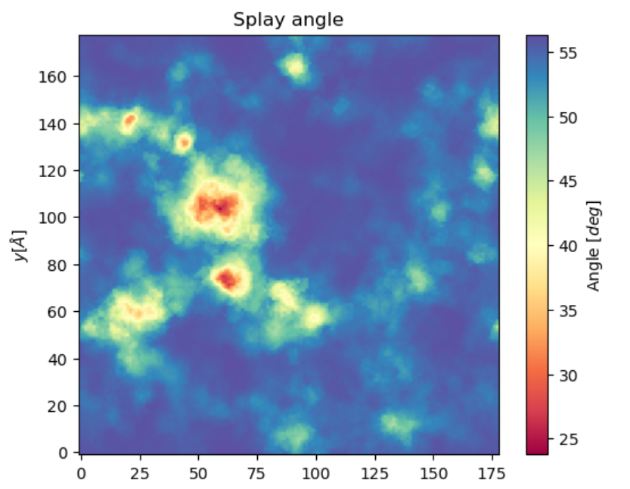
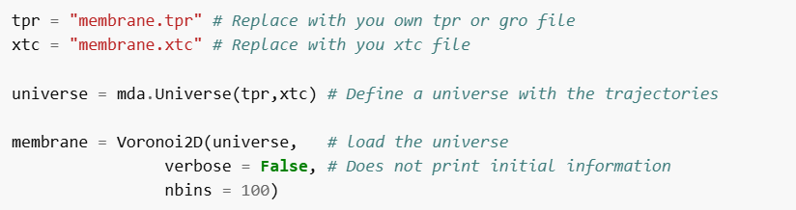
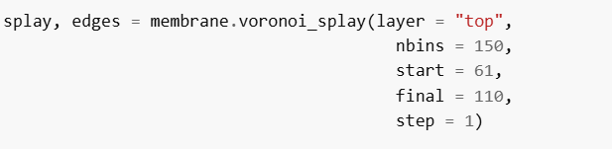
Voronoi2D

Slide 10
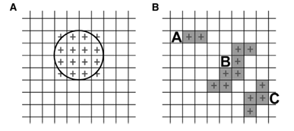
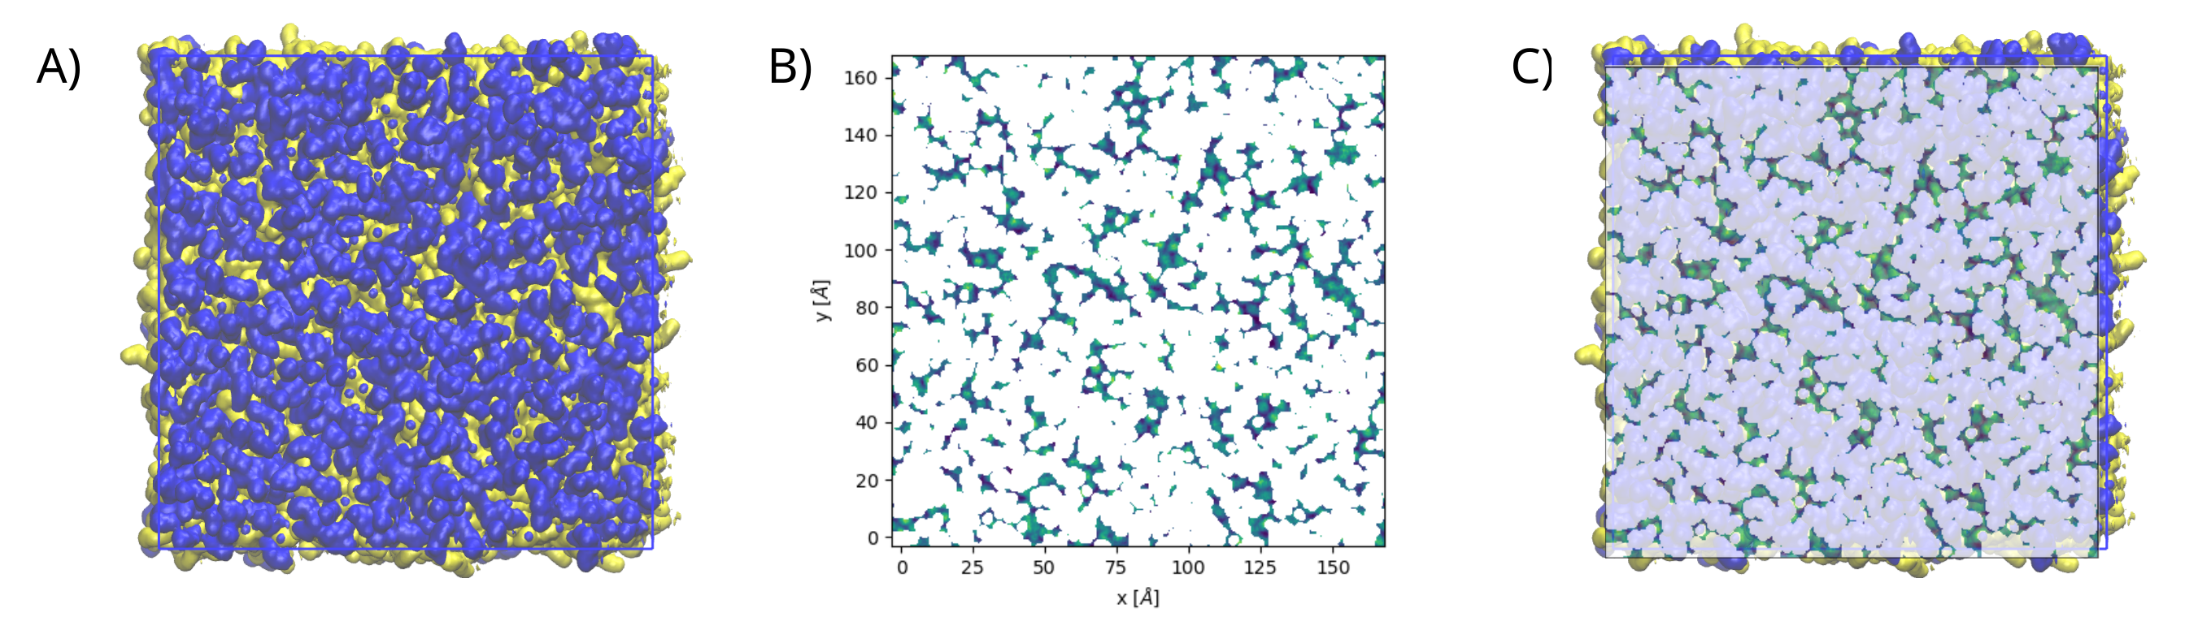
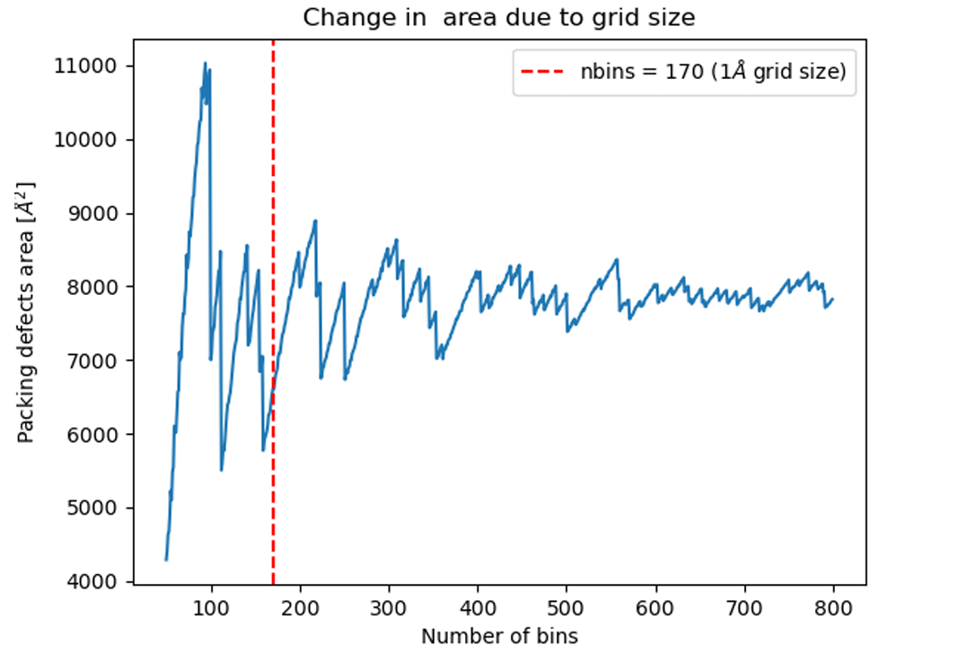
Packing Defects
Similar approach to PackMemb.
Optimized calculations by using python structures and atom selection facilitated by MDanalysis.
Packing defects for localized regions.
Gautier R, Bacle A, Tiberti M, Fuchs P, Vanni S and Antonny B. PackMem: a versatile tool to compute and visualize interfacial packing defects in lipid bilayers. Biophys J. 2018 Jul 5. doi: 10.1016/j.bpj.2018.06.025.

Slide 11
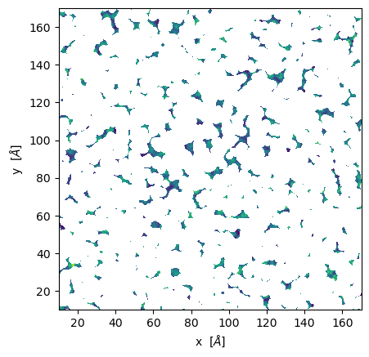
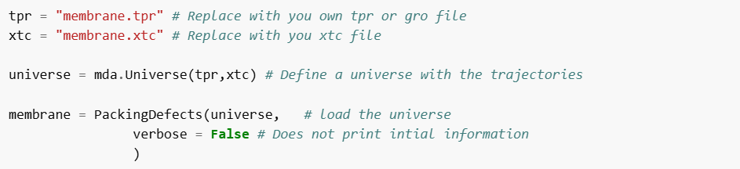
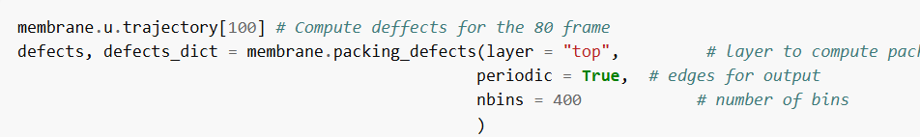
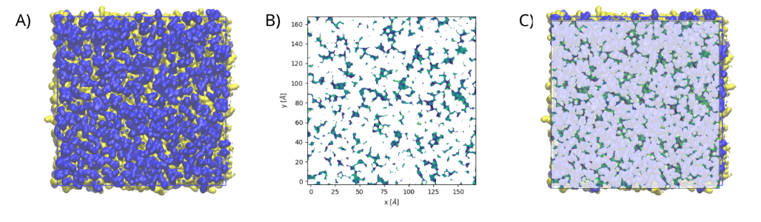
Packing defects

Slide 12
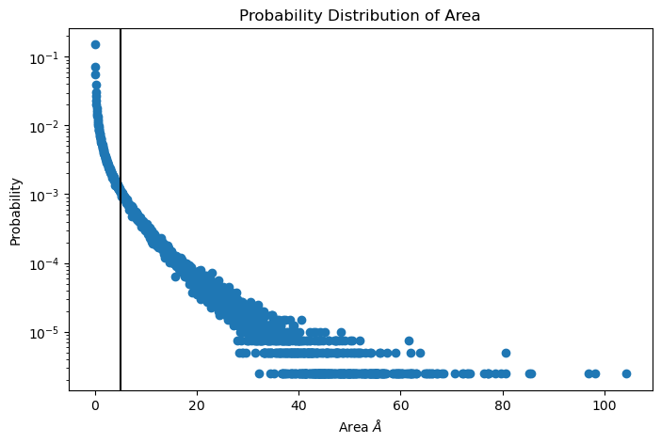
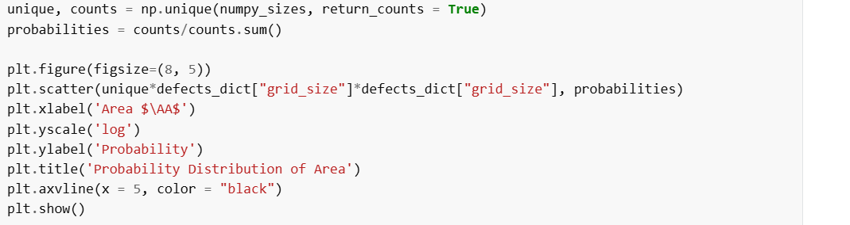
Packing defects

Slide 13
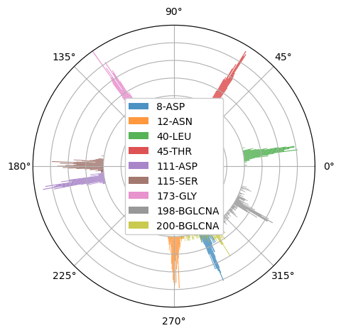
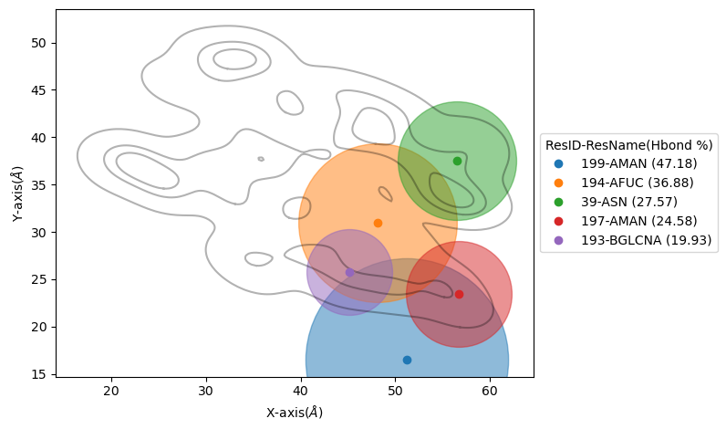
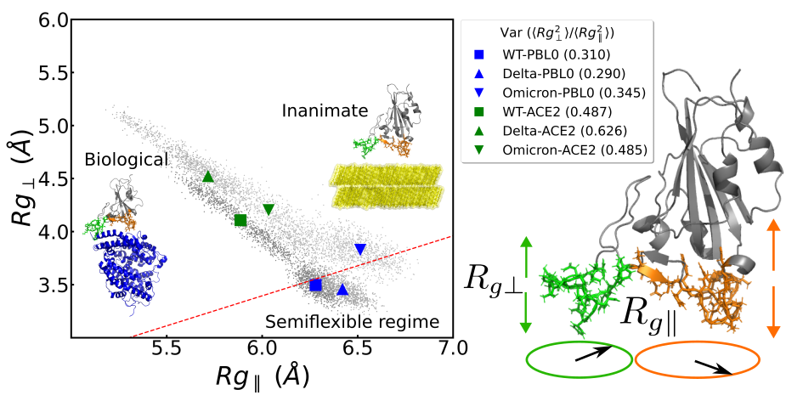
Biopolymer2D
Provides information of the Biopolymer during adsorption or when it is already bonded to the membrane.
Polar histograms.
2D position density contours.
Parallel and perpendicular radii or gyration.
Hydrogen bonds per residues.

Slide 14
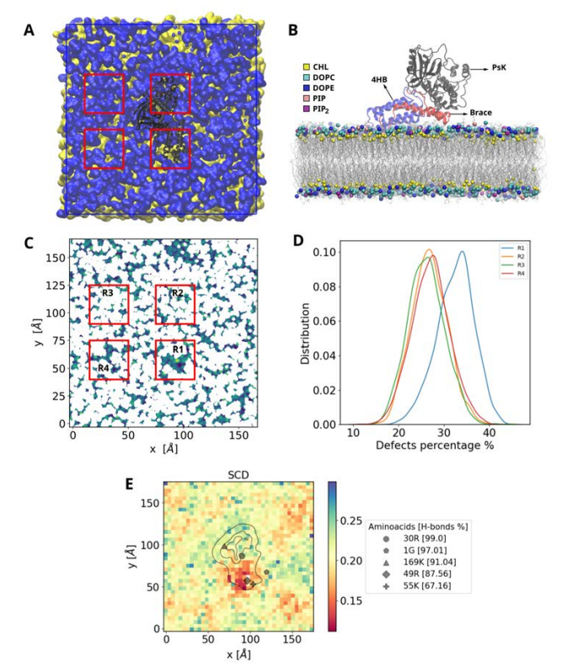
Combined usage example
Allows to easily explore the system.
Biopolymer2D combines with Cumulative2D/Voronoi2D provide a big picture of the interaction.
Packing defects show the effect of protein insertion ito the membrane.
Biopolymer2D and membrane classes can be used independently or together.

Slide 15
Conclusions
2Danalysis is a powerful tool to explore membranes and adsorption to biopolymer into a surface.
MDAnalysis facilitates software building for biological processes.
Our 2D approach for membranes allows us to easily track local changes in membranes.
Our 2D approach for biopolymer allow us to understand the adsorption strength of a biopolymer.

Slide 16
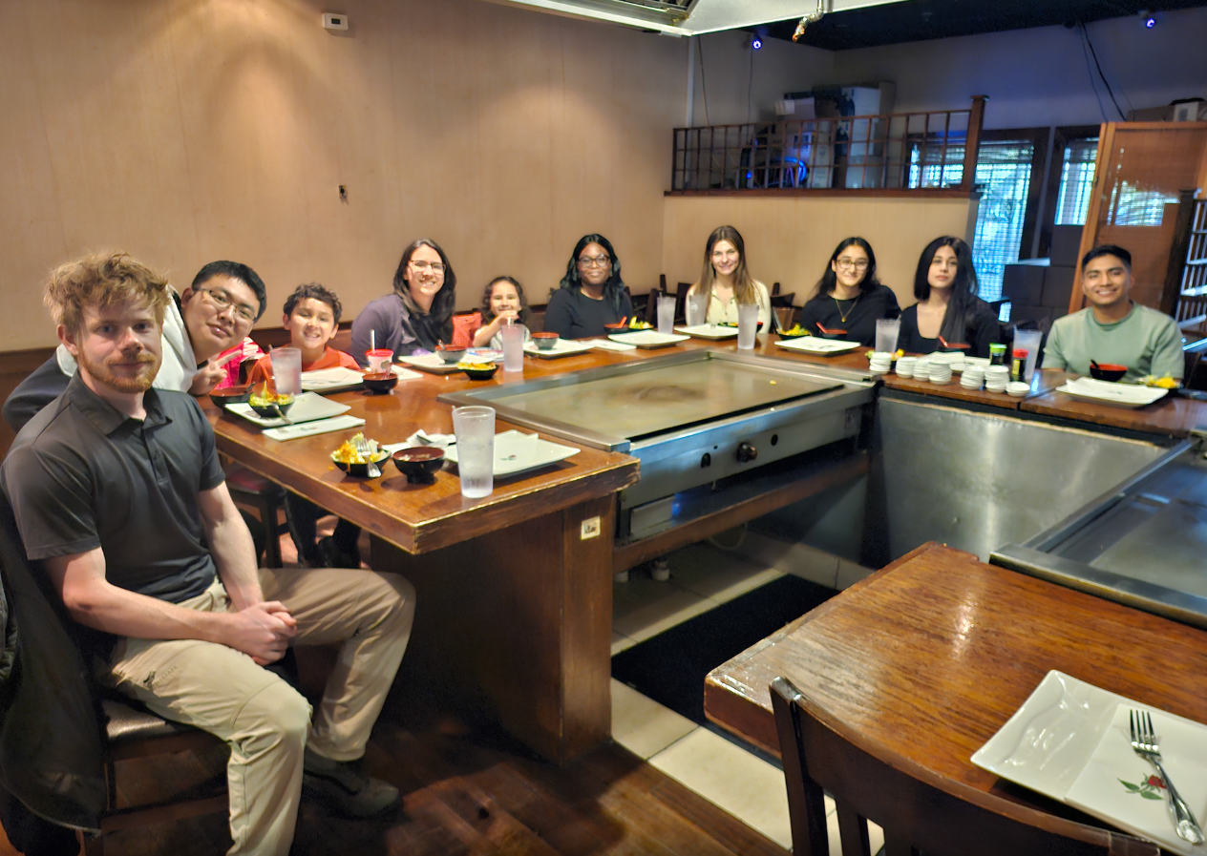
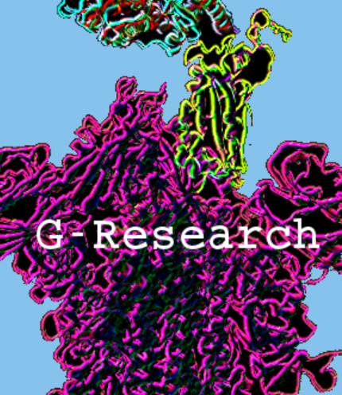



Acknowledgments
Dr. Viviana Monje
Jinhui Li
Toyin Campbell
Mahtab Firoozi

Slide 17


Thank You!
https://twodanalysis.readthedocs.io/en/latest/
https://doi.org/10.1016/j.bpj.2025.05.026

